Slide 1
Tableau dashboard 1,2,3
File created on: 06-08-2021 00:26:36

Slide 2
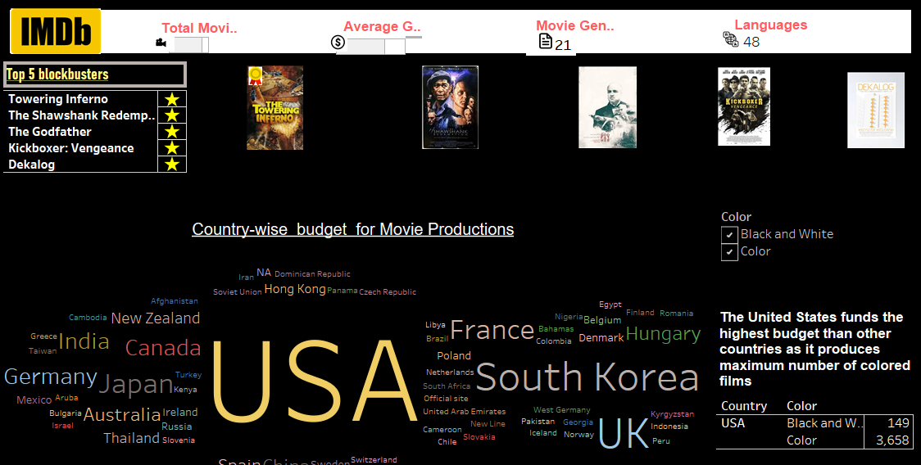

Slide 3
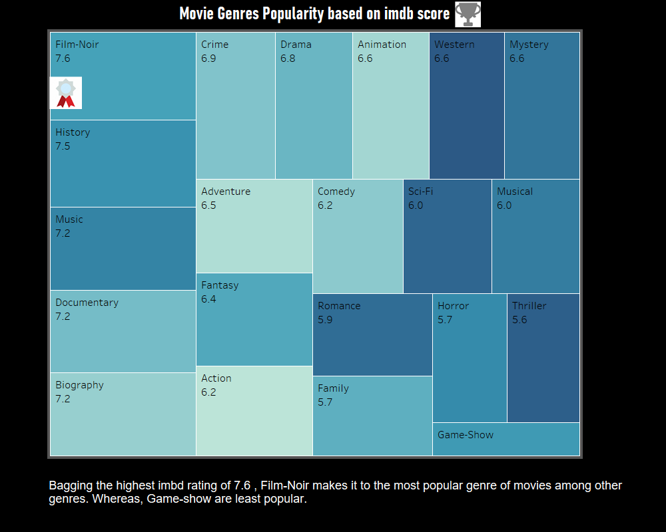

Slide 4
